Slide 1


Product Dissection for slack
Presented by –
Souvik Karmakar

Slide 2


Brief overview about slack
Slack Technologies, LLC is an American software company founded in 2009 in Vancouver, British Columbia, known for its proprietary communication platform Slack. Slack is a messaging app for business that connects people to the information they need. By bringing people together to work as one unified team, Slack transforms the way organizations communicate.

Slide 3

Slack product analysis
Slack is a workplace communication tool that provides a single place for messaging, tools, and files
1. It is an instant messaging system with lots of add-ins for other workplace tools
2. Slack is a popular choice for businesses and freelancers alike, as it makes communication easier for teams spread out across various locations
3. Slack offers thousands of integrations to easily connect software you already use to its platform, making it a viable hub for any type of business
4. Slack is easy to use, offers a free plan, and includes features to help increase productivity and visibility across all teams
5. Slack also allows companies to have a measure of control over who can use it through the invitation system . Slack is a great tool for teams that want to stay connected, work together, and get things done more efficiently .

Slide 4
Slack’s real-life problem solution by its extensive features
Problem 1:-Ineffective Team Communication
Real-World Challenge:
Within teams, the use of traditional communication technologies like email frequently leads to fragmented and sluggish communication. Important messages get’s lost , and collaboration becomes challenging.
Slack's Solution:
Slack addresses the challenge of fragmented communication by providing a centralized and organized messaging platform. Here's how:
Slack keeps messages organized in channels for different projects or teams, avoiding confusion.
Detailed discussions happen separately to keep the main chat clear.
It's easy to share files and integrate apps, making important information accessible in one place.
The powerful search function quickly finds messages and files, preventing any loss of crucial information and boosting team efficiency.

Slide 5
Continued…..
Problem 2: Context switching and overloading of information
Real-World Challenge:
Imagine you're working on a project, and you receive updates and messages scattered across different apps and email. It's like juggling multiple tasks at once, making it hard to focus. This overload of information disrupts your workflow, and switching between tools becomes a constant interruption, slowing down your productivity.
Slack’s solution:-
Slack's integrated platform helps with context change and information overload. How to do it is as follows:
Slack acts as a central hub for sharing files and messages, reducing the need to switch between various tools.
It integrates with many apps, bringing different capabilities into one place and minimizing context switches.
Users can customize notifications, so they only get alerts for specific terms or mentions, staying informed without feeling overwhelmed.
Channels in Slack are organized by topics or projects, preventing information overload by allowing users to focus on relevant discussions for their roles.

Slide 6
Continued…..
Problem 3: Distant Cooperation and Group Communication
Real-World Problem:
In a traditional office setting, team members could easily gather around a whiteboard to brainstorm ideas. However, with the shift to remote work, coordinating a spontaneous brainstorming session becomes challenging. The delay in communication and the absence of face-to-face interaction might lead to missed opportunities for creative collaboration, hindering the seamless teamwork that could have occurred in a physical office environment.
Slack's Solution:
Slack offers capabilities that improve team connectedness in order to address the difficulty of remote communication. Here's how to do it:
Slack allows teams to chat in real-time, helping distant members stay connected.
Voice and video calls within the app reduce the need for external tools, improving virtual collaboration.
Users can update their status, keeping the team informed about availability and ongoing work.
Channels provide visibility into active discussions and projects, enhancing remote participation and keeping everyone updated on team activities.

Slide 7
Continued…..
Problem 4: Simplifying Workflows and Project Management
Real-World Challenge:
Picture a team handling a complex project without a centralized platform. Team members might lose track of tasks, important details, and deadlines. Coordinating updates and progress becomes a challenge, leading to confusion about who is responsible for what. This lack of a unified system can result in delays, missed opportunities, and an overall inefficiency in project management.
Slack's Solution:
With tools that improve teamwork, Slack optimizes project management and processes. How to do it is as follows:
Teams can create channels dedicated to specific projects in Slack, allowing focused discussions, file sharing, and updates for each project.
Slack integrates with project management tools, providing users with task updates and notifications in one place, eliminating the need to switch between platforms.
Automation features in Slack, such as bots and custom connections, help teams automate repetitive processes, reducing manual work and improving workflow efficiency.
Collaborative document editing within Slack means users can work together on documents without needing external tools, simplifying the collaborative aspects of project work.

Slide 8
Summary of Slack’s top features
Top Features of Slack:
Channels: Organize conversations by topics, projects, or teams.
Direct Messages: Facilitate private one-on-one or small group discussions.
File Sharing: Seamlessly share documents, images, and files within conversations.
Message Threads: Keep discussions organized with threaded conversations.
App Integrations: Connect with a variety of apps for seamless workflow.
Search Functionality: Quickly find messages, files, and information within Slack.
Custom Notifications: Tailor notifications to stay informed without distractions.
Video and Voice Calls: Conduct video and voice calls directly in Slack.
Status Updates: Share availability and current tasks with team members.
Channel Visibility: Provide transparency into ongoing projects and discussions.

Slide 9
Schema Descriptions:
User Entity:
UserID (Primary Key): A unique identifier for each user.
Username: The username chosen for user identification.
Email: The user's email address for communication.
Password: Encrypted password for account security.
First_Name: The first name of the user.
Last_Name: The last name of the user.
Status: User's status indicating availability (online, offline, away, etc.).
Channel Entity:
ChannelID (Primary Key): A unique identifier for each channel.
Channel_Name: The name of the channel, representing a specific project, team, or topic.
Channel_Type: Indicates whether the channel is for general discussions, projects, or specific topics.

Slide 10
Continued…
Message Entity:
MessageID (Primary Key): A unique identifier for each message.
UserID (Foreign Key referencing User Entity): The user who sent the message.
ChannelID (Foreign Key referencing Channel Entity): The channel in which the message is posted.
Message_Content: The content of the message, including text, files, or links.
Timestamp: The timestamp indicating when the message was sent.
Integration Entity:
IntegrationID (Primary Key): A unique identifier for each integration.
Integration_Name: The name of the integrated app or tool.
Integration_Type: Indicates the type of integration, such as project management, file sharing, etc.

Slide 11
Continued….
Task Entity:
TaskID (Primary Key): A unique identifier for each task.
UserID (Foreign Key referencing User Entity): The user assigned to the task.
ChannelID (Foreign Key referencing Channel Entity): The channel associated with the task.
Task_Description: Details about the task, including deadlines and updates.
Task_Status: Indicates the status of the task (pending, completed, in progress, etc.).

Slide 12
Relationships
Users send Messages in Channels.
Many-to-Many Relationship: Users can send messages in multiple channels, and each channel can have multiple users sending messages.
Users are associated with Tasks in Channels.
One-to-Many Relationship: A user can be assigned to multiple tasks, but each task is associated with one user.
Channels contain Messages.
One-to-Many Relationship: A channel can have multiple messages, but each message is associated with one channel.
Channels have Integrations.
One-to-Many Relationship: A channel can be integrated with multiple apps, but each integration is associated with one channel.

Slide 13
Justification for the Design
The primary entities that are part of Slack's collaboration platform are reflected in the schema design.
The Message entity logs user messages.
The Integration entity controls integrated apps
The User object gathers vital user data, the Channel entity provides various channels for projects and conversations.
The Task entity maintains task assignments and modifications.
To ensure data integrity and enable smooth communication, links between entities are essential. Messages are sent by users inside channels, tasks are linked to certain users and channels, and integrations expand the features of the platform.

Slide 14
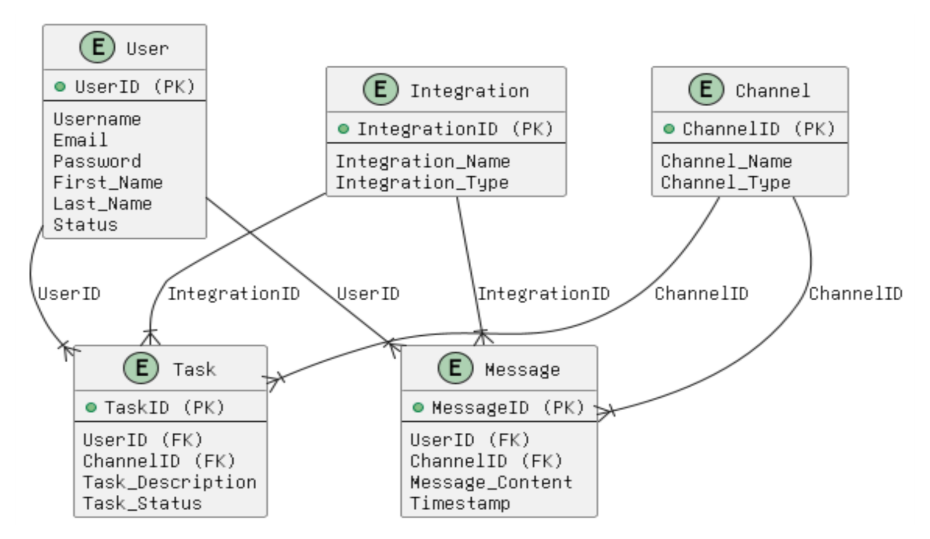
ER diagram

Slide 15
In this schema design:
User Entity:
Represents users with unique identification, including username, email, and status.
Channel Entity:
Depicts channels for organized communication, with a focus on the channel's name and type.
Message Entity:
Captures messages sent by users in specific channels, detailing content and timestamp.
Integration Entity:
Manages integrations with external apps or tools, featuring a unique identifier and type.
Task Entity:
Tracks tasks assigned to users in specific channels, encompassing descriptions and status indicators.
The relationships emphasize connectivity: users sending messages, users associated with tasks, messages belonging to channels, and channels having integrations. This schema promotes effective collaboration and information flow within the platform.

Slide 16

conclusion
By taking on this project, we were able to explore Slack's complex infrastructure and understand the underpinnings of its collaboration platform. To provide a detailed knowledge of the structure and interconnection of data, the investigation comprised breaking down important elements including users, channels, messages, integrations, and tasks. Through this practical examination, we were able to elucidate the subtleties of Slack's design philosophy, emphasizing its focus on user-centric features, integrated workflows, and efficient communication. We learned a lot about how Slack's schema tackles practical issues via our investigation, which solidifies its standing as the industry standard for teamwork solutions.

Slide 17


